Slide 1
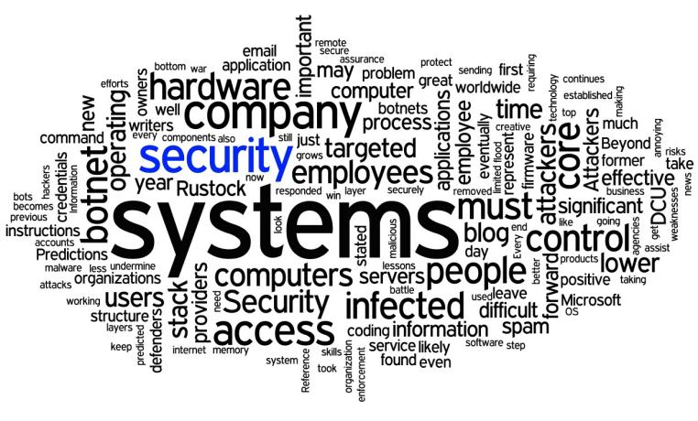
Introduction to Information Security
School of Computer Science and IT JAIN (DEEMED-TO-BE UNIVERSITY) Department of Bachelor of Computer Applications
Module 1

Slide 2

Topics to be covered :
Definition of Information Security
History of Information Security
Basic principles of Information Security
Critical concept of Information Security
Components of Information Security
Balancing Information security and access
Implementing IT security
The System Development Life cycle
Security professional in the organization

Slide 3
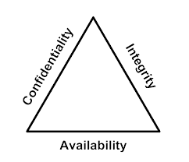
1. Definition of Information Security
Practice of defending information from unauthorized access, use, disclosure, disruption, modification, perusal, inspection, recording or destruction. It is a general term that can be used regardless of the form the data may take (e.g. electronic, physical)
Where it has been used?
Governments, military, financial institutions, hospitals, and private businesses.
Protecting confidential information is a business requirement.
Information security (IS) is designed to protect the confidentiality, integrity and availability of computer system data from malicious intentions
Many large enterprises employ a dedicated security group to implement and maintain the organization's information security program

Slide 4
2. History of Information Security
What is security?
security is defined as,
“The quality or state of being secure—to be free from danger.”
Types of Security
Physical security
Personal security
Operations security
Communications security
Network security
Information security

Slide 5
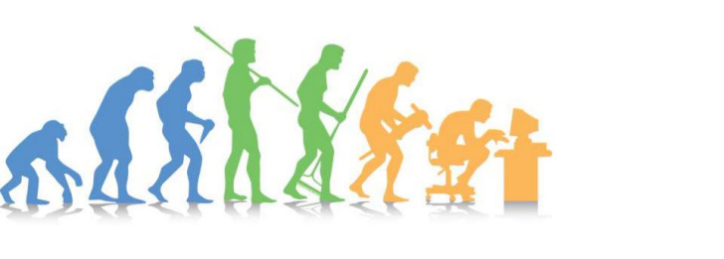
History
Computer security began immediately after the first mainframes were developed
Groups developing code-breaking computations during world war II created the first modern computers
Physical controls were needed to limit access to authorized personnel to sensitive military locations
Only rudimentary controls were available to defend against physical theft, espionage, and sabotage

Slide 6
Evolution- 1960
Department of Defense’s Advanced Research Project Agency (ARPA) began examining the feasibility of a redundant networked communications
Larry Roberts developed the project from its inception

Slide 7
The 1970’s and 80’s
ARPANET grew in popularity as did its potential for misuse
Fundamental problems with ARPANET security were identified
No safety procedures for dial-up connections to ARPANET
Non-existent user identification and authorization to system
Late 1970s: microprocessor expanded computing capabilities and security threats

Slide 8
MULTICS
Much of the early research on computer security centered on a system called Multiplexed Information and Computing Service (MULTICS)
However it is now obsolete, MULTICS is notable as it was the first operating system to combine security into its core functions.
It was a mainframe, time-sharing operating system generated in the mid- 1960s by a group of General Electric (GE), Bell Labs and the Massachusetts Institute of Technology (MIT)

Slide 9
The 1990’s
Networks of computers became more common; so too did the need to interconnect networks
Internet became first manifestation of a global network of networks
In early Internet deployments, security was treated as a low priority

Slide 10
The Present
The Internet brings millions of computer networks into communication with each other—many of them unsecured
Ability to secure a computer’s data influenced by the security of every computer to which it is connected

Slide 11

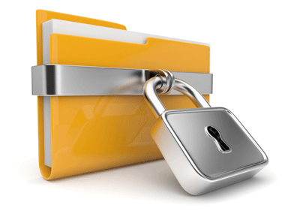

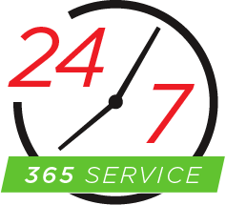
3. Basic Principles of Information Security
Confidentiality
Integrity
Information Security
Availability

Slide 12
Brief Description
Information security principles used in broadest context which includes principles, standards, conventions and mechanisms
These basic principles of Information Security are also called “key concepts of Information Security”
The CIA triad of confidentiality, integrity, and availability is at the heart of information security
CIA is called as Security Triad
AAA refers to authentication, authorization, and accounting
AAA is used in the process of access control to secured resources

Slide 13
Basic principles address the following properties of information
Confidentiality: This means that information is only being seen or used by people who are authorized to access it
Integrity: This means that any changes to the information by an unauthorized user are impossible (or at least detected), and changes by authorized users are tracked
Availability: This means that the information is accessible when authorized users need it

Slide 14
Attributes of Information Security
Confidentiality
Make sure that the necessary level of secrecy is forced at all the junction of data processing and secures unauthorized disclosure
This makes sure that unauthorized users do not interrupt copy or duplicate information
Threat sources
Network monitoring
Stealing password files
Countermeasures
Encrypting data as it is stored and transferred
Implementing strict access control methods and data classification

Slide 15
Cont…
Integrity
The protection and assurance of the reliability, consistency and accuracy of classified data throughout its life
This means securing concealed and unauthorized changes of data either in storage or whereas it transit
Threat sources
Viruses
Logic bomb
Countermeasures
Strict access control
Intrusion detection

Slide 16
Cont…
Availability
Information should be accessible for use if needed by authorized services and users
Threat sources
Device or software failure
Denial-of-service (DoS) attacks
Countermeasures
Preserving backups to restore the failed system
IDS to check the network traffic and host system activities

Slide 17
4. Critical concepts of Information Security
The value of information comes from the concepts it possesses
When a concept of information changes, the value of that information either increases or more commonly decreases
Some concepts affect information’s value to users more than others do, this can depend on circumstances
Example, timeliness of information can be a critical factor, because information loses much or all of its value when it is delivered too late

Slide 18
Diagrammatic Representation
Confidentiality
Integrity
Availability
Privacy
Identification
Authentication
Authorization
Accountability
Accuracy
Utility
Possession

Slide 19
Critical Characteristics Of Information
The value of information comes from the characteristics it possesses.
Privacy
Identification
Authentication
Authorization
Accountability
Accuracy
Utility
Possession

Slide 20
Cont…
Privacy – Legal Use - It related to individual person E.g. Keeping credit card information by bank is ‘Privacy’
Identification – It is ability to identify uniquely a user of a system or an application. Ex. Who you claim to be? Username , Bio metrics
Authentication- which we use to describe situations when we need to identify who we are and we prove that we are who we say we are
For example, username and password is one mode of authentication
Authorization- which we use to describe what access authenticated user has
Basically, we describe what the user is authorized to work with
to as the AAA of remote access

Slide 21
Cont…
Accounting- which is used to describe logging
Logging means keeping track of what someone did on the system
Accuracy – Free from Mistakes or Error
Utility - Utility of information is the quality or state of having value for some purpose or end
Information has value when it can serve a purpose
Possession - Possession of information is the quality or state of ownership or control
Information is said to be in one’s possession if one obtains it, independent of format or other characteristics.

Slide 22
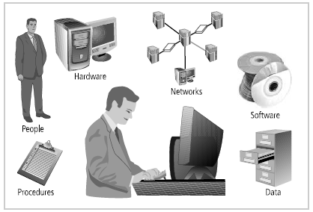
5. Components of information System & Security

Slide 23
5. Components of information System
Information system (IS) is much more than computer hardware
It is the whole set of software, hardware, data, people, procedures and networks which make probable the use of information resources in the organization
These six critical components enable information to be input, processed, output and stored
Each of these IS components has its own strengths and weaknesses and also as its own characteristics and uses
Each component of the information system also has its own security needs

Slide 24
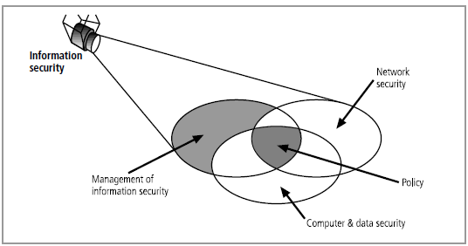
Cont…

Slide 25
Components of an Information System: Definitions
Software: The software components of IS comprises applications, operating systems, and
assorted command utilities. Software programs are the vessels that carry the lifeblood
of information through an organization.
Hardware: It’s the physical technology that houses and executes the software, stores and carries the data, and provides interfaces for the entry and removal of information from the system.
Data: Data stored, processed, and transmitted through a computer system must be protected.
People: There are many roles for people in information systems. Common ones include
Systems Analyst
Programmer
Technician.

Slide 26
Cont: Definitions
Procedure: A procedure is a series of documented actions taken to achieve something.
A procedure is more than a single simple task.
A procedure can be quite complex and involved, such as performing a backup, shutting down a system, patching software.
Networks: When information systems are connected to each other to form Local Area Network (LANs), and these LANs are connected to other networks such as the Internet, new security challenges rapidly emerge.

Slide 27
Securing Components
The computer can be either or both the subject of an attack and/or the object of an attack.
Subject of an attack – Computer is used as an active tool to conduct the attack.
Object of an attack – Computer itself is the entity being attacked.
Two Types of Attack:
Direct Attack: When a Hacker uses his personal computer to break into a system.
Indirect Attack: A system is compromised and used to attack other system.

Slide 28
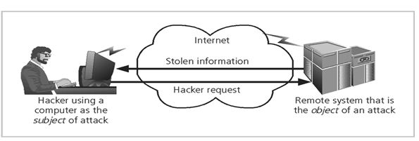
Securing Components representation

Slide 29
6. Balancing Information Security & Access
Information security should balance protection and availability
It is possible to make a system available to anyone, anywhere, anytime, through any means
However, such unrestricted access poses a danger to the integrity of the information
On the other hand, a completely secure information system would not allow anyone access
To achieve balance—that is, to operate an information system that satisfies the user and the security professional
Level of security must allow reasonable access, yet protect against threats

Slide 30
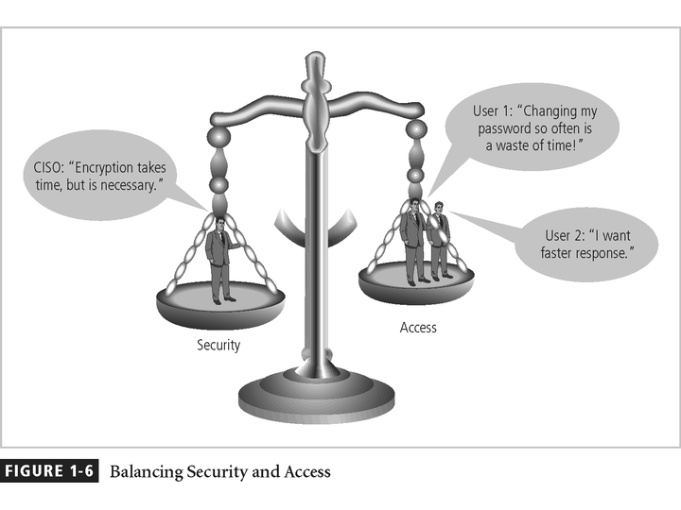
Competing voices that must be reconciled in the information security versus access balancing act

Slide 31
Cont..
An imbalance can occur when the needs of the end user are undermined by heavy a focus on protecting and administering the information systems
Both information security technologists and end users- recognize that both groups share the same overall goals of the organization
To ensure the data is available when, where, and how it is needed, with minimal delays or obstacles
In an ideal world, this level of availability can be met even after concerns about loss, damage, interception, or destruction have been addressed

Slide 32
Principles of Least privilege
The principle of least privilege is the practice of limiting access to the minimal level that will allow normal functioning
Applied to employees, the principle of least privilege translates to giving people the lowest level of user rights that they can have and still do their jobs
Example
A backup user does not need to install software
Hence, the backup user has rights only to run backup and backup-related applications
Any other privileges, such as installing new software, are blocked

Slide 33
Cont..
Benefits of the principle include
Better system stability
Better system security
Ease of deployment

Slide 34
Need to know
The aim is to make it difficult for unauthorized access to occur, without inconveniencing legitimate access
Need-to-know also aims to discourage "browsing" of sensitive material by limiting access to the smallest possible number of people
Problems
Need-to-know (like other security measures) can be misused by persons who wish to refuse others access to information they hold in an attempt to increase their personal power, prevent unwelcome review of their work, prevent embarrassment resulting from actions or thoughts

Slide 35
7. Implementing IT security
Implementing information security involves identifying specific threats and creating specific controls to counter those threats
The essential elements of an effective IT security program
Periodically assess risk
Document an entity-wide security program plan
Establish a security management structure and clearly assign security responsibilities
Implement effective security-related personnel policies
Monitor the security program’s effectiveness and make changes as necessary

Slide 36
Approaches to Information Security Implementation
Its an incremental process requires coordination, time and patience.
Two type of approaches
Bottom Up Approach
Top Down Approach

Slide 37
Bottom Up Approach
Security from a grass-roots effort - systems administrators attempt to improve the security of their systems
Key advantage - technical expertise of the individual administrators
Seldom works, as it lacks a number of critical features:
participant support
organizational staying power

Slide 38
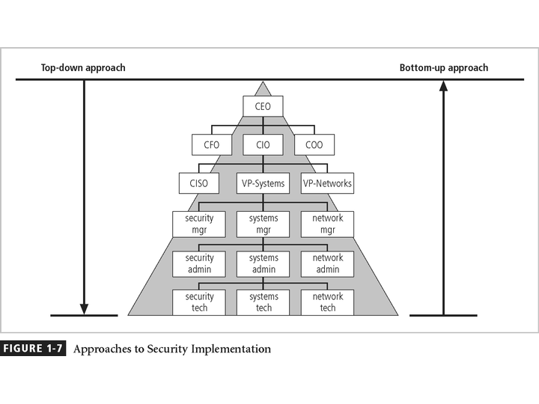
Figure 1-7 – Approaches to Security Implementation

Slide 39
Top-down Approach
Initiated by upper management:
issue policy, procedures, and processes
dictate the goals and expected outcomes of the project
determine who is accountable for each of the required actions
This approach has strong upper management support, a dedicated champion, dedicated funding, clear planning, and the chance to influence organizational culture
May also involve a formal development strategy referred to as a systems development life cycle
Most successful top-down approach

Slide 40
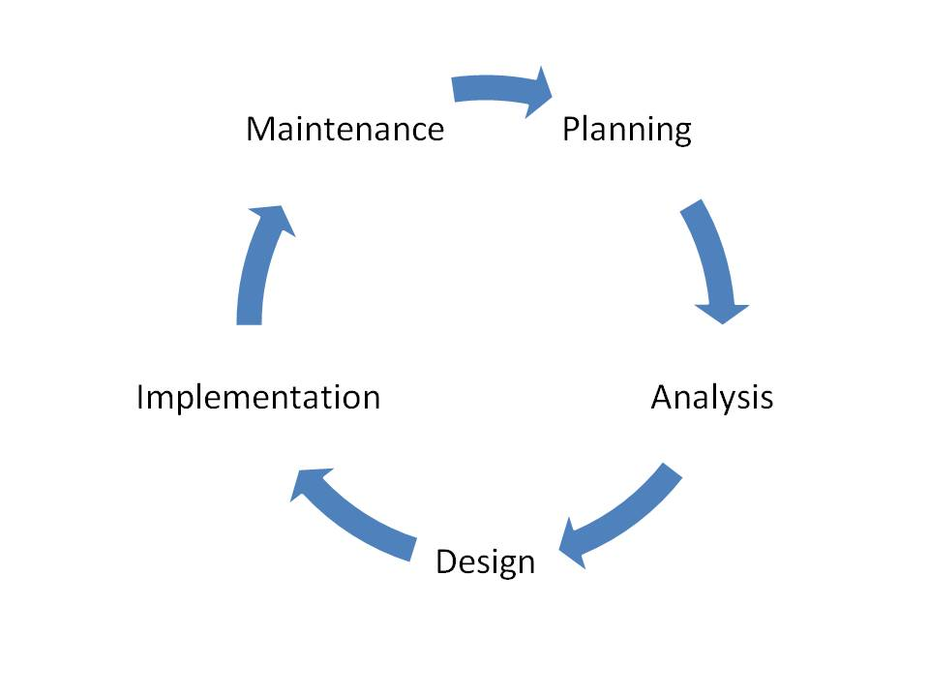
8. The SDLC
SDLC is a detailed plan to create, develop, test and eventually implement a software
Software development is a complex process and to manage this complexity of number of SDLC models or methodologies have been created
Objectives of SDLC
Ensures the delivery of high quality systems
Provide strong management control
Maximize productivity

Slide 41
Investigation
What is the problem the system is being developed to solve?
The objectives, constraints, and scope of the project are specified
A preliminary cost/benefit analysis is developed
A feasibility analysis is performed to assesses the economic, technical, and behavioral feasibilities of the process

Slide 42
Analysis
Consists primarily of
assessments of the organization
the status of current systems
capability to support the proposed systems
Analysts begin to determine
what the new system is expected to do
how the new system will interact with existing systems
Ends with the documentation of the findings and a feasibility analysis update

Slide 43
Logical Design
Based on business need, applications are selected capable of providing needed services
Based on applications needed, data support and structures capable of providing the needed inputs are identified
Finally, based on all of the above, select specific ways to implement the physical solution are chosen
At the end, another feasibility analysis is performed

Slide 44
Physical Design
Specific technologies are selected to support the alternatives identified and evaluated in the logical design
Selected components are evaluated based on a make-or-buy decision
Entire solution is presented to the end-user representatives for approval

Slide 45
Implementation
Components are ordered, received, assembled, and tested
Users are trained and documentation created
Users are then presented with the system for a performance review and acceptance test

Slide 46
Maintenance and Change
Tasks necessary to support and modify the system for the remainder of its useful life
The life cycle continues until the process begins again from the investigation phase
When the current system can no longer support the mission of the organization, a new project is implemented.

Slide 47
Strength & Weakness of SDLC
Strength
Control
Monitor large projects
Detailed steps
Easy to maintain
Weakness
Increased development time & cost
Rigidity
Hard to estimate project overruns

Slide 48
Secure SDLC
The same phases used in the traditional SDLC adapted to support the specialized implementation of a security project.
Basic process is identification of threats and controls to counter them.
The Sec SDLC is a coherent program rather than a series of random, seemingly unconnected actions.
Investigation
Analysis
Logical design
Physical design
Implementation
Maintenance and change

Slide 49
Investigation / Analysis
Identifies process, outcomes and goals of the project, and constraints
Begins with a statement of program security policy
Teams are organized, problems analyzed, and scope defined, including objectives, and constraints not covered in the program policy
An organizational feasibility analysis is performed.
Phases:
Security Categorization: low , moderate or high
Preliminary Risk Assessment: description of basic security needs.

Slide 50
Cont…
Analysis of existing security policies or programs, along with documented current threats and associated controls
Includes an analysis of relevant legal issues that could impact the design of the security solution
The risk management task (identifying, assessing, and evaluating the levels of risk) also begins

Slide 51
Logical & Physical design
Creates blueprints for security
Critical planning and feasibility analyses to determine whether or not the project should continue
In physical design, security technology is evaluated, alternatives generated, and final design selected
At end of phase, feasibility study determines readiness so all parties involved have a chance to approve the project

Slide 52
Logical & Physical Design Phases
Risk Assessment
Security Functional Requirement Analysis
Security Assurance Requirement Analysis
Cost Consideration and Reporting
Security Planning
Security Control Development
Developmental Security Test and Evaluation
Other Planning Components

Slide 53
Implementation
The security solutions are acquired (made or bought), tested, and implemented, and tested again
Personnel issues are evaluated and specific training and education programs conducted
Finally, the entire tested package is presented to upper management for final approval
Phases:
Inspection and Acceptance
System Integration
Security Certification
Security Accreditation

Slide 54
Maintenance and Change
The maintenance and change phase is perhaps most important, given the high level of ingenuity in today’s threats
As new threats emerge and old threats evolve, the information security profile of an organization requires constant adaptation
Phases
Configuration Management and Control
Continuous Monitoring
Information Preservation
Media Sanitization
Hardware and Software Disposal

Slide 55
9. Security professionals in the organization
Wide range of professionals required to support a diverse information security program
Senior management is key component and the vital force for a successful implementation of an information security program
But administrative support is also essential to developing and executing specific security policies and procedures, and technical expertise is of course essential to implementing the details of the information security program

Slide 56
Cont…
Chief Information Officer (CIO)
Senior technology officer
Primarily responsible for advising senior executives on strategic planning
Chief Information Security Officer (CISO)
Primarily responsible for assessment, management, and implementation of IS in the organization
Usually reports directly to the CIO

Slide 57
Information Security Project Team
A number of individuals who are experienced in one or multiple requirements of both the technical and non-technical areas:
The champion : Senior Executive ,promotes project and ensures support both financially and administratively
The team leader : Project Manager ,who understand Project Management and info security technical requirements.
Security policy developers: individuals who understands organizational culture ,policies and requirements for successful implementation.
Risk assessment specialists: individuals who understands financial risk assessment techniques.

Slide 58
Information Security Project Team Cont…
Security professionals : Dedicated , trained and well educated specialists both technically and non technically.
Systems administrators : Individuals with the primary responsibility for administering the systems .
End users : Those whom the new system will most directly affect.

Slide 59
Data Ownership
Data Owner - responsible for the security and use of a particular set of information. Member of senior management.
Data Custodian – working directly with data owners, responsible for the storage, maintenance, and protection of the information .
Data Users - the end systems users who work with the information to perform their daily jobs supporting the mission of the organization

Slide 60
10. Summary
Thus we came to know about,
Information security evolved from the early field of computer security
Basic principles
The critical characteristics of information
Components of information security
Balancing & implementing IS
The traditional systems development life cycle (SDLC)
Security professionals in the organization

Slide 61
Thank you

